Slide 1

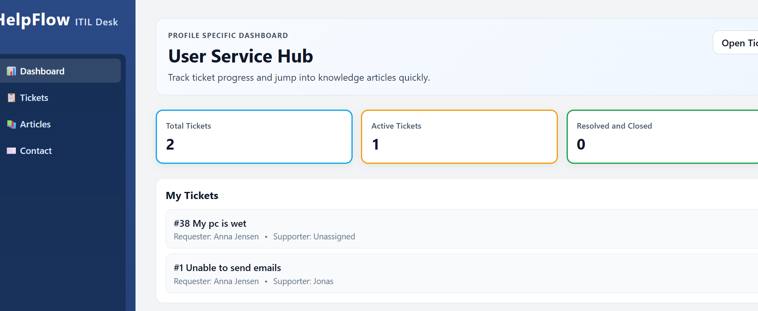
Helpflow ITIL-Desk
Mathias Haurum Løyche

Slide 2





Introduction – What have I made?

Slide 3
Tech-stack
Frontend
Angular
Typescript
Backend
Express
Database
MySQL 8+

Slide 4

Design Patterns
Component-based Architecture
Service layer pattern
Reactive state pattern
Router-driven lazy loading
Singleton

Slide 5
Directory Structure
{Helpflow-backend} Node/Express API layer for tickets, articles and SLA endpoints
{db} Database connection setup
{routes} REST route handlers
{node_modules} Backend dependencies
{Helpflow-frontend} Angular application (UI, routing, pages, components, services)
{src/app} Root and Core app code folder
{layout/main-layout} Main sidebar, content + footer wrapper
{pages} Route-level feature pages - containing all page views
{services} API/data and app-wide services
{shared} Reusable shared components like sidebar
{public} Static assets, SQL files and docs
{.angular} Angular CLI cache/build metadata
{node_modules} Frontend dependencies

Slide 6
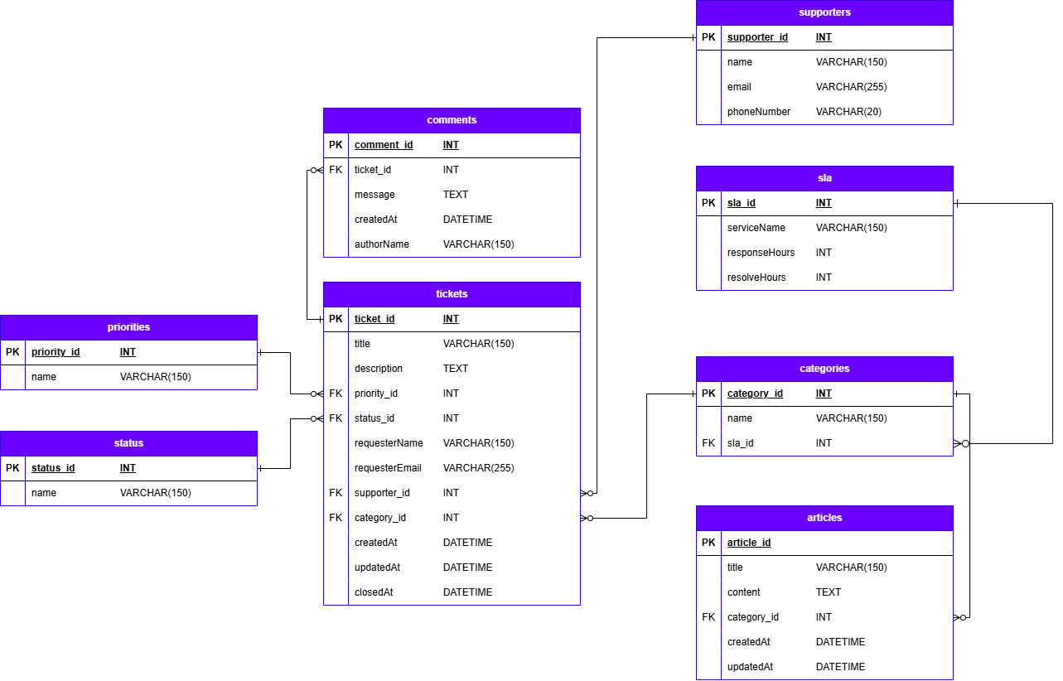
Database

Slide 7
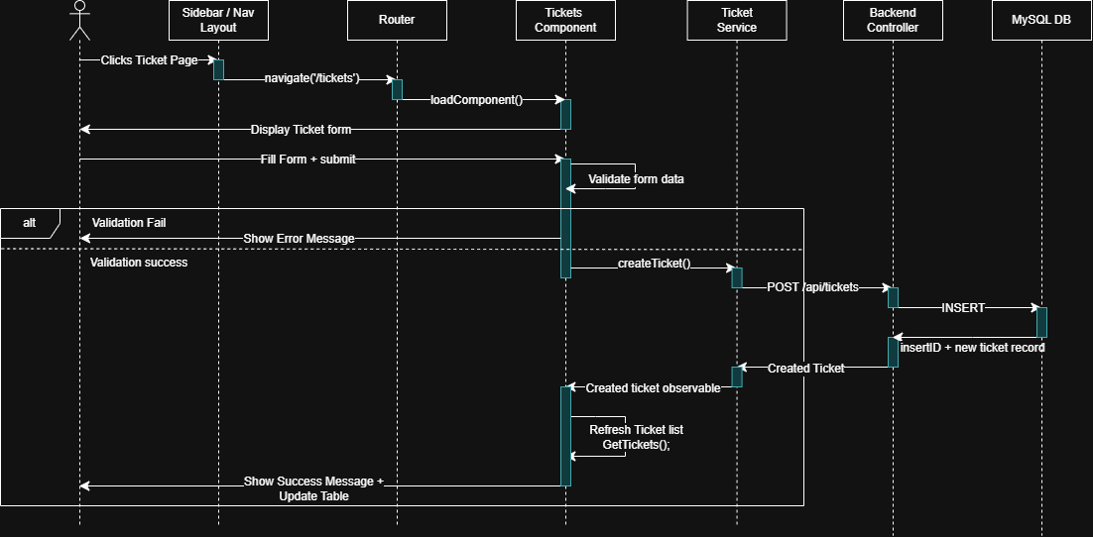
Sequence-diagram (Create Ticket)

Slide 8
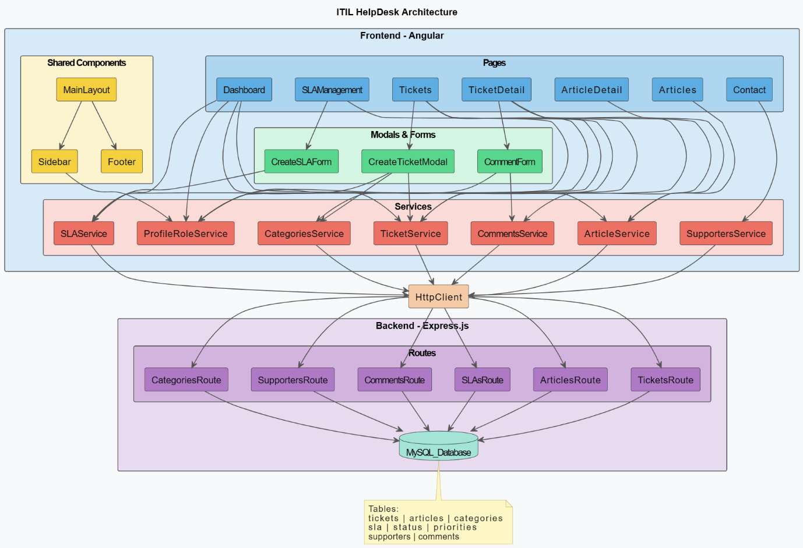
Component Diagram

Slide 9
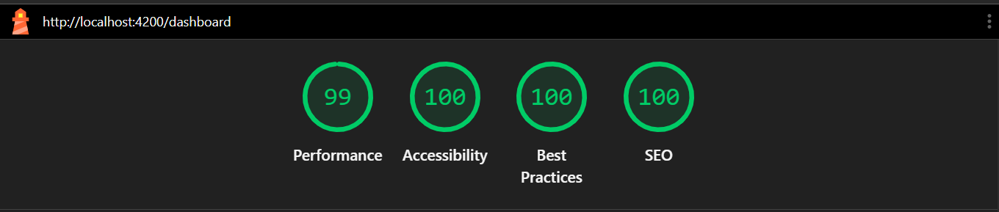

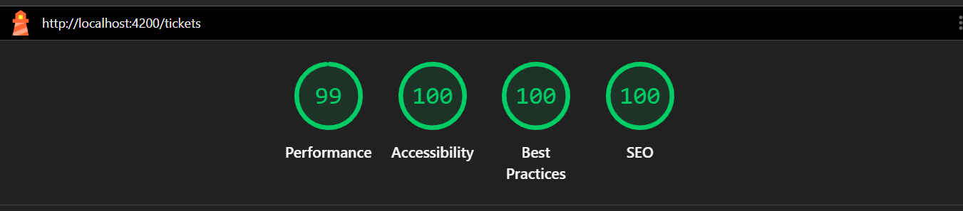
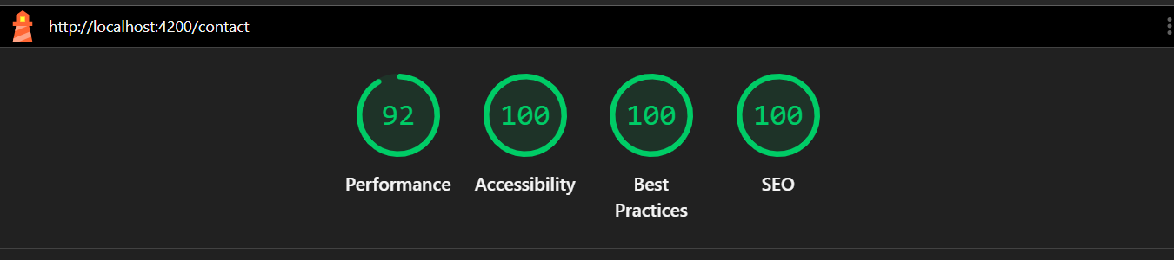

Lighthouse Tests

Slide 10

Practical showcase!

Slide 11

Questions?

